Slide 1

BCA Ist Semester
Introduction of Logic Circuit and Digital Design(ILCDD)
Course Code: BCAC003
Presented by:
Mr.Anuj Kumar
Assistant Professor, Dept. Of CE&A
GLA University, Mathura

Slide 2
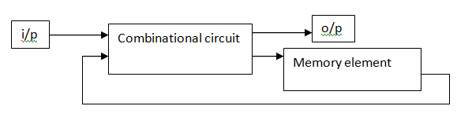
SEQUENTIAL LOGIC CIRCUITS
Sequential logic circuit consists of a combinational circuit with storage elements connected as a feedback to combinationalcircuit
output depends on the sequence of inputs (past and present)
stores information (state) from past inputs
Figure 1: Sequential logic circuits

Slide 3
SEQUENTIAL LOGIC CIRCUITS
Sequential circuit receives the binary informationfrom external inputs and with the present state of the storage elements together determine the binary value of the outputs.
The output in a sequential circuit are a function of not only the inputs, but also the present state of the storage elements.
The next state of the storage elements is also afunction of external inputs and the present state.

Slide 4
Combinational vs. Sequential
Combinational Circuit
always gives the same output for a given set of inputs ex: adder always generates sum and carry, regardless of previous inputs
Sequential Circuit
stores information
output depends on stored information (state) plus input so a given input might produce different outputs, depending on the stored information
example: ticket counter
advances when you push the button output depends on previous state
useful for building ―memory‖ elements and ―state machines

Slide 5
STORAGE ELEMENTS
Storage elements in a digital circuit can maintain a binary state
indefinitely, until directed by an input signal to switch states.There are two types of storage elements.
Latches
Flipflops
Storage elements that operate with signal level are referred as latch
and those controlled by a clock transition are referred as flipflops.

Slide 6
LATCHES
LATCHES:
A latch has a feedback path, so information can be retained by the device. Therefore latches can be memory devices, and can store one bit of data for as long as the device is powered.
Latches are very similar to flip-flops, but are not synchronous devices, and do not operate on clock edges as flip-flops do.
Latch is a bistable multivibrator
FLIPFLOPS:
A flip-flop is a circuit that has two stable states and can be used to store state information.
A flip-flop is a bistable multivibrator.
The circuit can be made to change state by signals applied to one or more control inputs and will have one or two outputs.
It is the basic storage element in sequential logic.

Slide 7
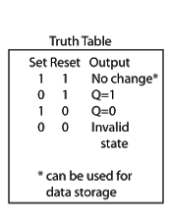
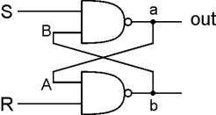
LATCHES
SR LATCH
An SR latch (Set/Reset) is an asynchronous device: it works independently of control signals and relies only on the state of the S and R inputs.
In the image we can see that an SR flip-flop can be created with two NAND Gates that have a cross-feedback loop.
In this case, it is sometimes called an SR latch.

Slide 8
R is used to ―reset or ―clear the element – set it to zero.
S is used to ―set element – set it to one.
If both R and S are one, out could be either
zero or one.
―holds its previous value.
note: if a is 1, b is 0, and vice versa

Slide 9
Flip flops
A flip flop is an electronic circuit with two stable states that can be used to store
binary data.
The stored data can be changed by applying varying inputs. Flip-flops and latches are fundamental building blocks of digital electronics systems used in computers, communications, and many other types of systems.
Flip-flops and latches are used as data storage elements.

Slide 10
There are 4 types of flipflops
RS flip flop
Jk flip flop
D flip flop
T flip flop
Applications of Flip-Flops
These are the various types of flip-flops being used in digital electronic circuits and the applications like Counters, Frequency Dividers, Shift Registers, Storage Registers

